Slide 1

Sea level rise risk analysis
Emmitt Hasty and Kenny Phan

Slide 2
Introduction
Emmitt Hasty: MSDS candidate
Kenny Phan: PhD Geosciences

Slide 3

Problems
Sea Level Rise is becoming a concerning issue for many coastal areas. As global warming continues to threaten Polar ice caps and the expansion of seawater as it warms, it threatens areas of the coast and the populations that make their livelihood there.

Slide 4
Our attempt to address
We have built a model to assess risk for coastal cities and their vulnerability to sea levels rising. We began with Florida. We use many valuable data values to classify this risk, namely the elevation of the counties used, the population, the income, the land use and land cover, and the actual projected sea level rise for the area. We use these values to classify risk into three classes, low, medium, and high.

Slide 5

Data science Methodologies
Much of the data was geospatial, so lots of data wrangling was needed in order to prepare the data for meaningful analysis.
It became important for us to split the data into the county-by-county data, for both analysis and visualization purposes.
Once the data was in a usable form, split by county data, we were able to start incorporation machine learning algorithms to assess the data automatically, so that we can expand to more data in the future.
Several methods were tested, with one more in the pipeline to test.

Slide 6
Data
Shapefiles were gathered detailing the Florida county data that gave us access to the county geometric data, as well as the relevant populace data. Geopandas is a subset of the pandas python library, which was used for us to handle these shapefiles and develop tabular format. This allowed us to succinctly hold the income, population, elevation, land cover and land use, and the sea level rise data. What makes geopandas special is its ability to hold geometric data, which separates it from pandas.

Slide 7

Innovation and novelty
While much of this data is openly and publicly available, much of the analysis that has been done on this data, is much more globally focused, with little specialization for local analysis. It has been our intention to prioritize the novelty of localizing this data, focusing on state size data, and specializing for the use of the states used.

Slide 8
Impact, Feasibility & benefits
The benefits are widespread for the state of Florida, as it details the strenuous impact sea level rise will have on current predictions. Our hope is to expand the service to be able to handle different state data, with little data wrangling necessary by the user. This will have a major impact for the states in question, as they will be able to see their vulnerability.

Slide 9

Results
Certain results are easy to validate, as certain counties are visible to the eye which will be high risk to sea level rise, for our purposes, the Miami-Dade county is our metric for what the highest risk looks like. It is the highest population county in Florida, and it is very low elevation and lower income as well. As such, we were able to build our risk scoring assessment to treat this as the highest scored county. Orange County is the lowest risk due to its high elevation, so that was our metric for the lowest risk.

Slide 10
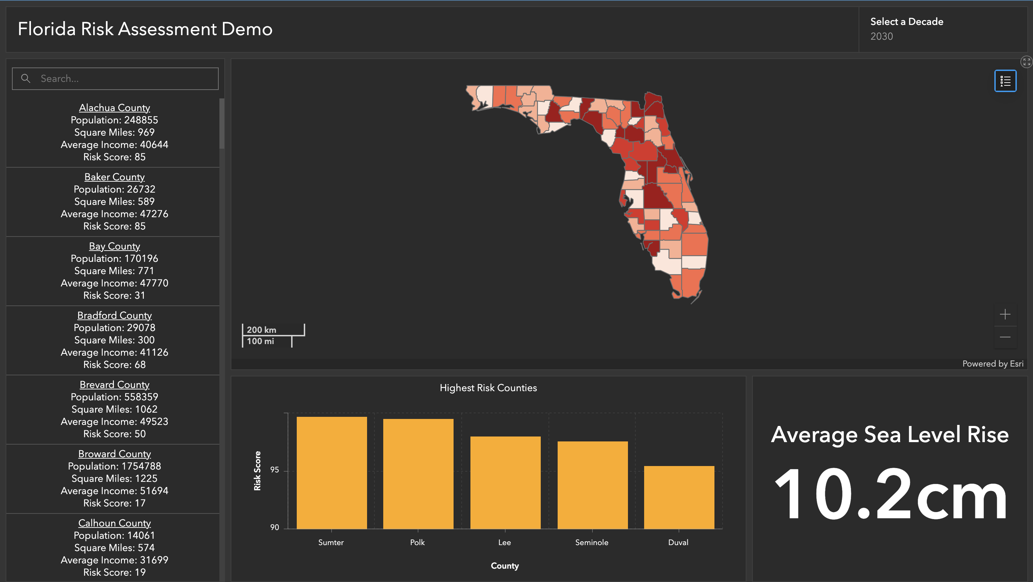
Conclusion & Future vision
Initial results are promising, and our hope is to expand this data to more states, to provide a risk assessment for them to understand their vulnerabilities to the changing seas.

